Slide 1
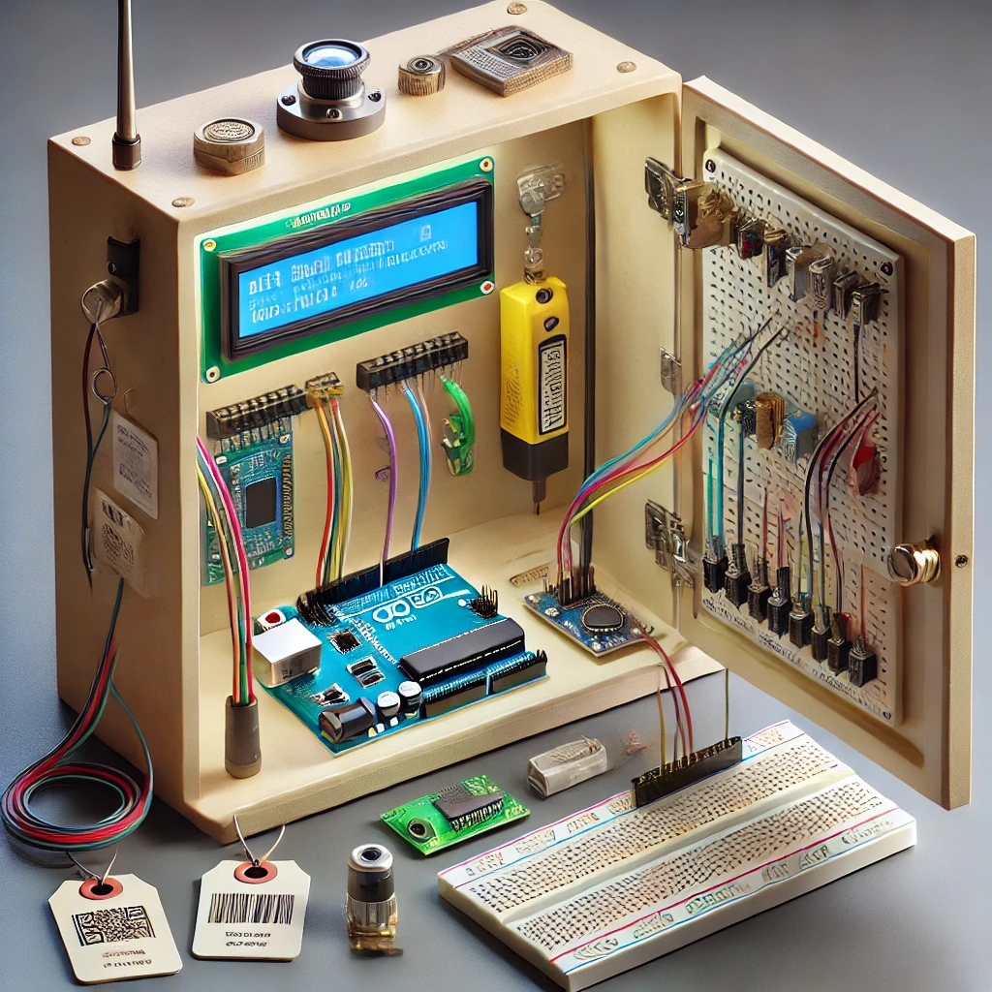
RfId based-tool tracking system

Slide 2
introduction
Utilizes RFID technology with the RFID RC522 module to scan tags assigned to tools and borrowers
It designed to improve the management and accountability of tools within a cabinet
It introduces a reliable method for tracking the tools borrowed by personnel.

Slide 3

Problem
Current challenges
Manual tool tracking system is time-consuming and prone to errors.
Misplaced or unreturned tools lead to delays and increased operational costs.
Lack of accountability makes it difficult to monitor who has borrowed a tool and its return status.
consequences
e
Delayed maintenance activities due to missing tools.
Increased operational costs and reduced productivity.
Risks to safety and interruptions in critical maintenance tasks.

Slide 4
Solution
Real time tracking
User Authorization
Uses RFID technology to monitor tool location and usage in real time.
Restricts tool access to authorized personnel only through RFID cards.
Enhanced Tool Management
alerts
Alerts for overdue tools, ensuring timely returns and accountability.
Reduces tool misplacement and loss, minimizing maintenance delays and operational costs.

Slide 5
Design Approach
Material needed
RFID RC522 Module
Ultrasonic Sensor (HC-SR04)
16x2 LCD Display
Servo Motor (SG90)
Buzzer
Breadboard and Jumper Wires
Microcontroller (Arduino Uno)
Power Supply (5V Battery or Power Adapter)
Tool Cabinet/Box

Slide 6

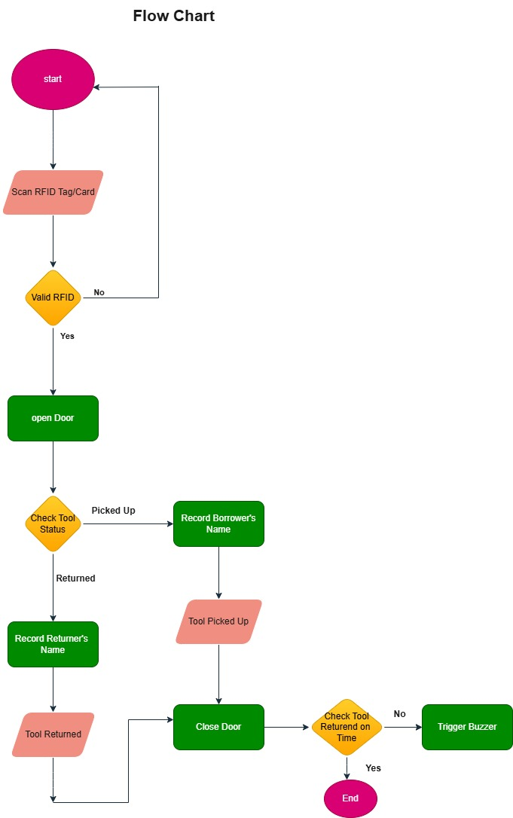
Flow charts

Slide 7
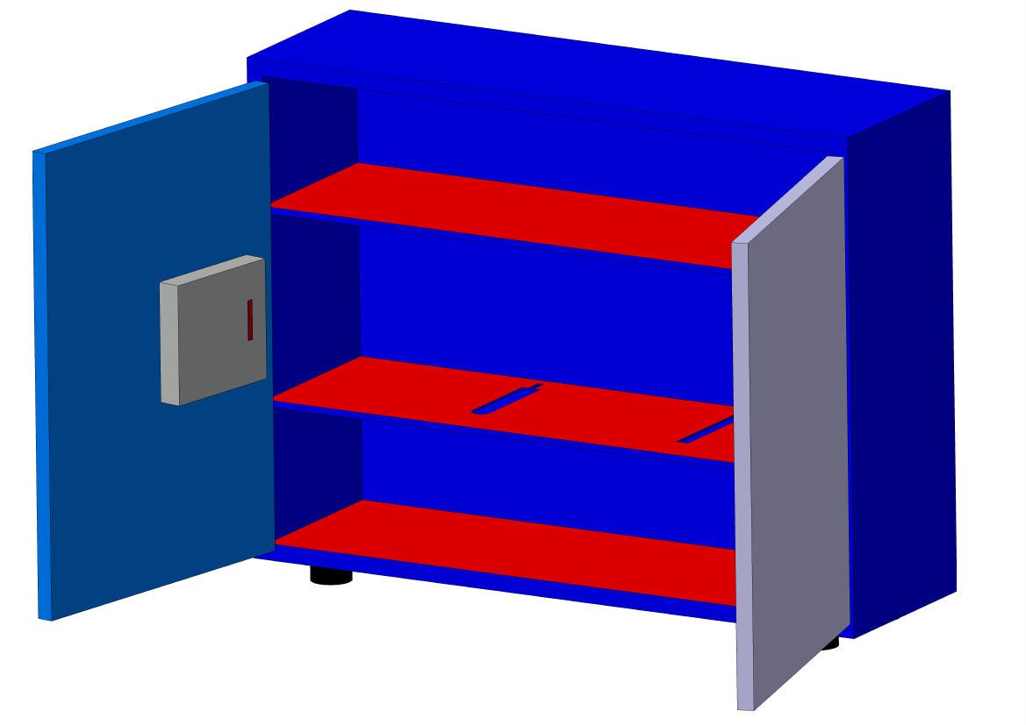
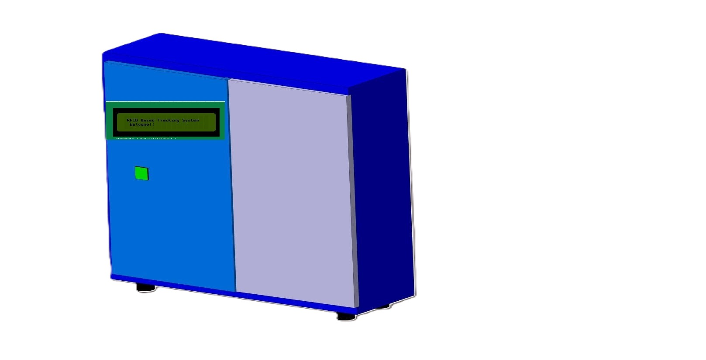
3d model for the cabnet

Slide 8

Thank you
​

